Slide 1
Epidemics Propagation in Complex Networks
André Filipe Neves Calatré – 73207
Departamento de Física – Universidade de Aveiro
Projeto 2016/2017

Slide 2
Why this topic?
In an increasingly connected world, epidemic processes are more and more preponderant.
Multidisciplinary, multiple applications:
Health
Physics
Economics
Social Sciences

Slide 3
Background

Slide 4
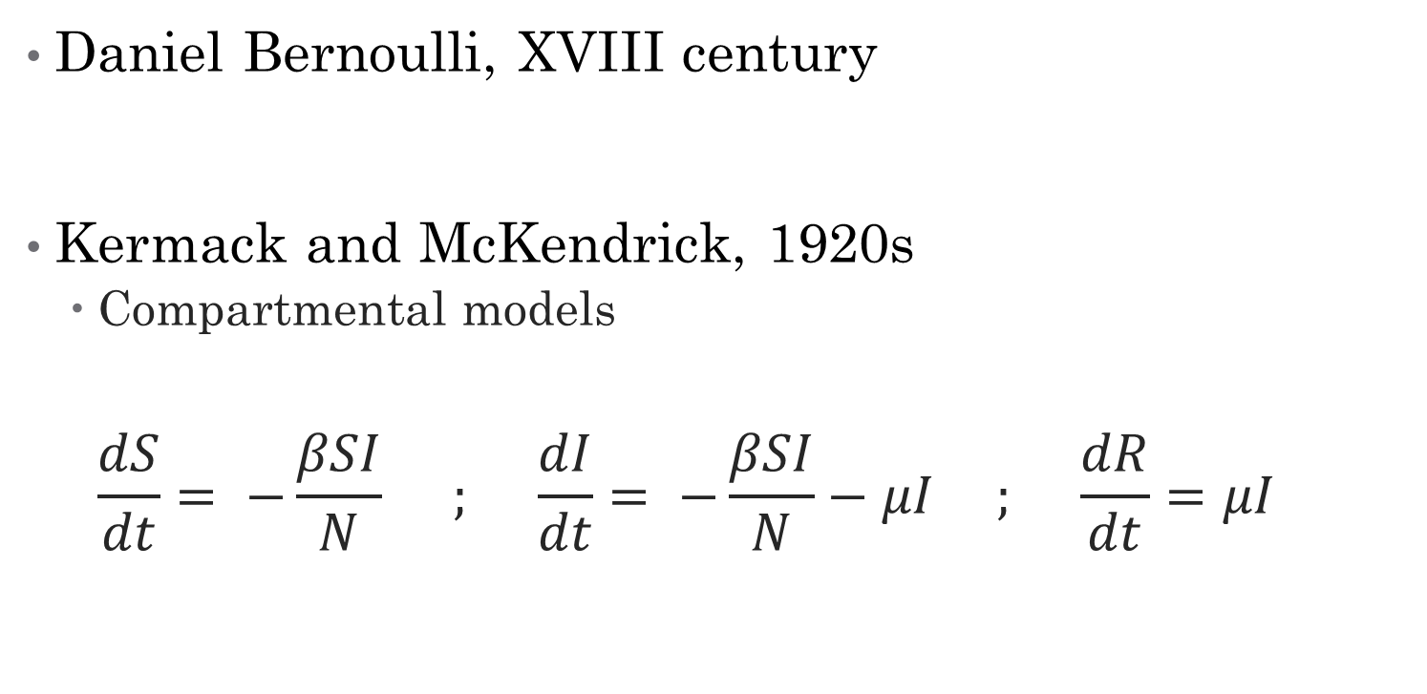
Classical Epidemic Models
Daniel Bernoulli, XVIII century
Kermack and McKendrick, 1920s
Compartmental models
$$\frac{dS}{dt}= −\frac{βSI}{N} ; \frac{dI}{dt}= −\frac{βSI}{N}−μI ; \frac{dR}{dt}=μI$$

Slide 5
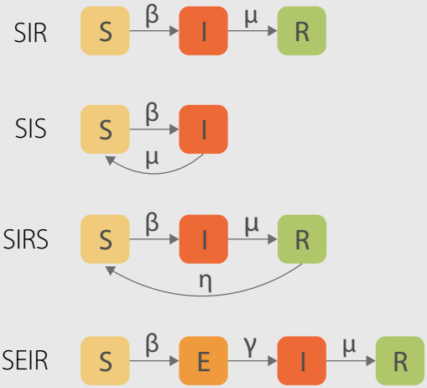
Classical Epidemic Models

Slide 6
Networks
Graphs
Describe connections
Particularly relevant for describing epidemics in the real world
3 cases studied
Non-Spatial (no network effect)
Square Lattice
Sphere Lattice

Slide 7
Stochastic Processes
Processes where the evolution of a system is ruled by a set of probabilistic events.
Epidemics can be described as a stochastic process

Slide 8
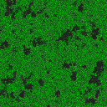
An example – The Forest Fire Model

Slide 9
Development

Slide 10
Creating the Simulations
Based on a Python Forest Fire Model script
Creating a Lattice
Define Evolution Rules
Iterate them repeatedly

Slide 11
Capturing the Data
On previous simulations, add a counter
Measure every iteration
Store it in a DataFrame
Do multiple simulations
Multiple variables
Average & Standard Deviation

Slide 12
Results

Slide 13
Overall Facet Grids
For a matrix of
c, r = [0.01, 0.02, 0.03, 0.04, 0.05, 0.06, 0.07, 0.08, 0.09, 0.1, 0.25, 0.5, 0.75, 1]

Slide 14
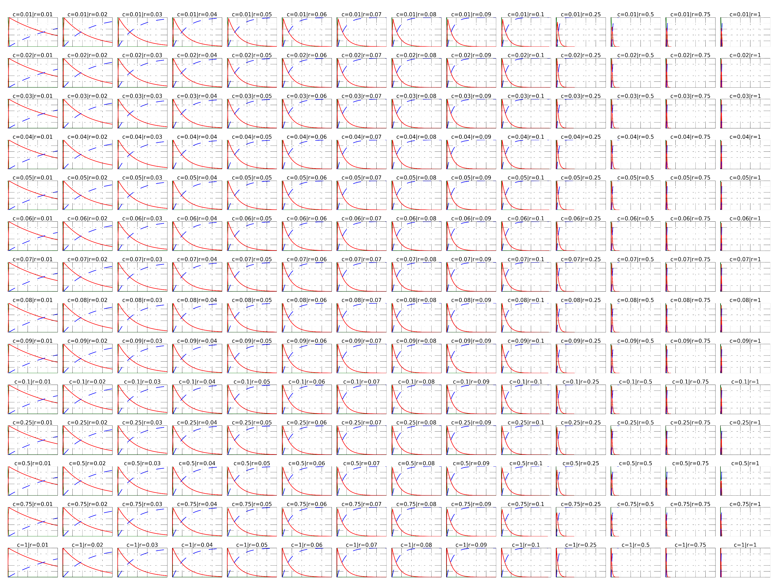
Non-Spatial Case Facet Grid

Slide 15
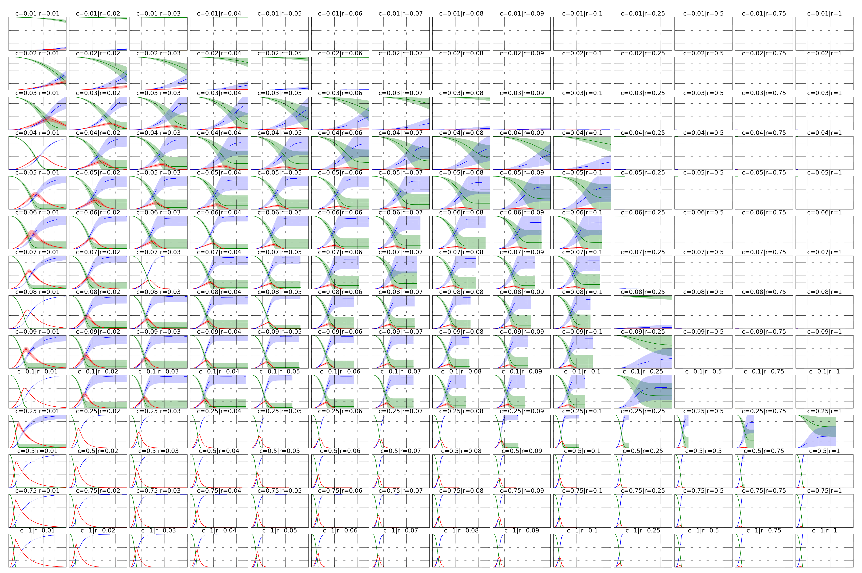
Spherical Lattice Facet Grid

Slide 16
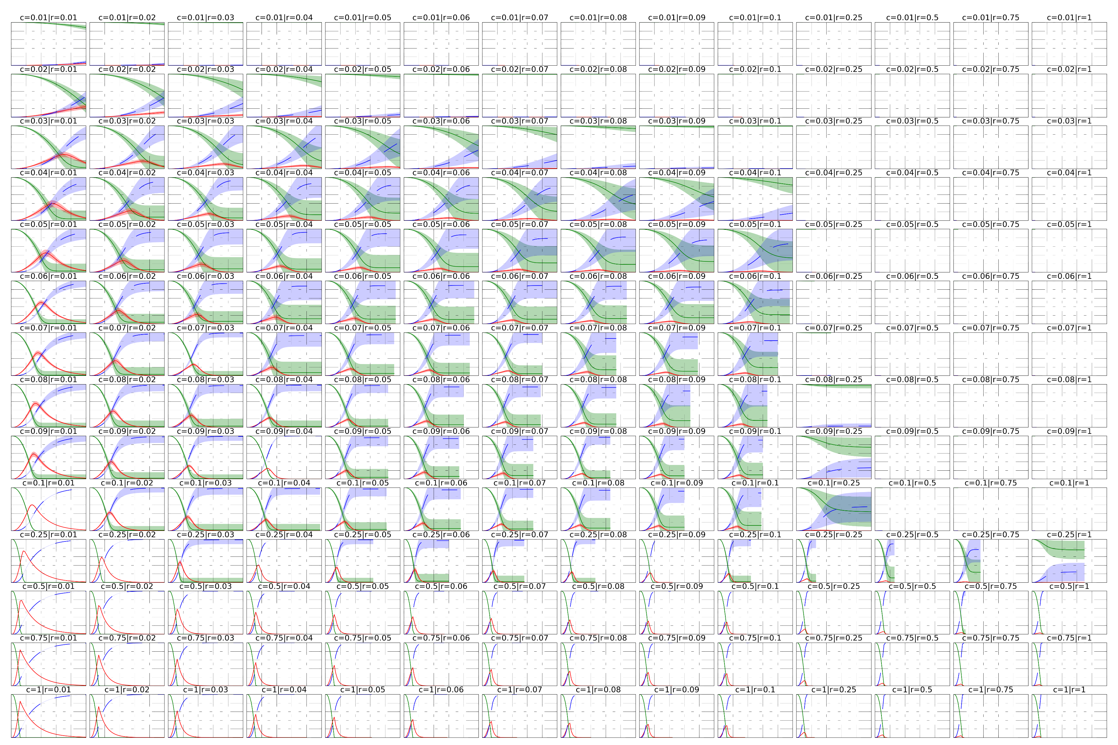
Square Lattice Facet Grid

Slide 17
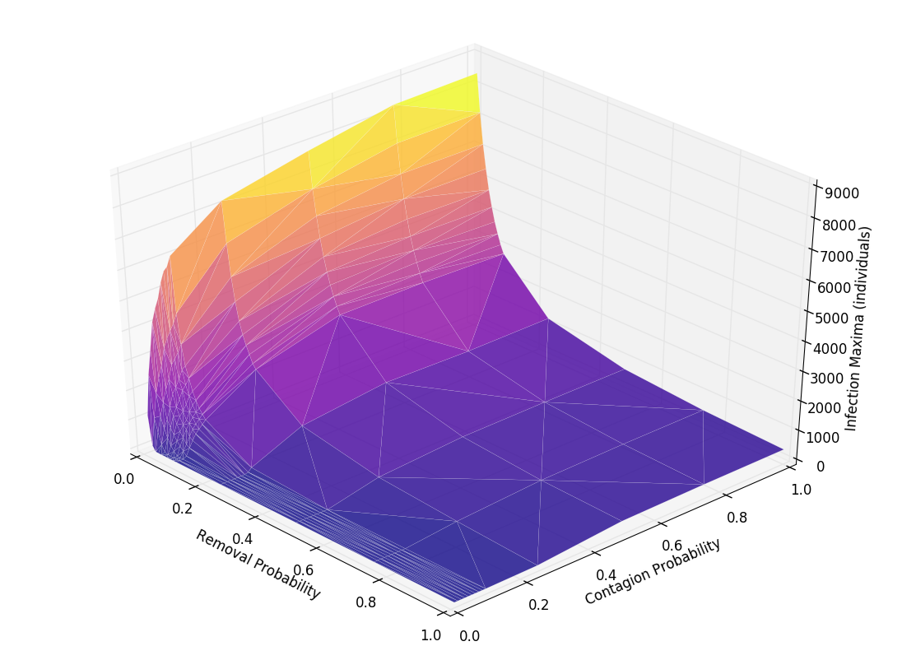
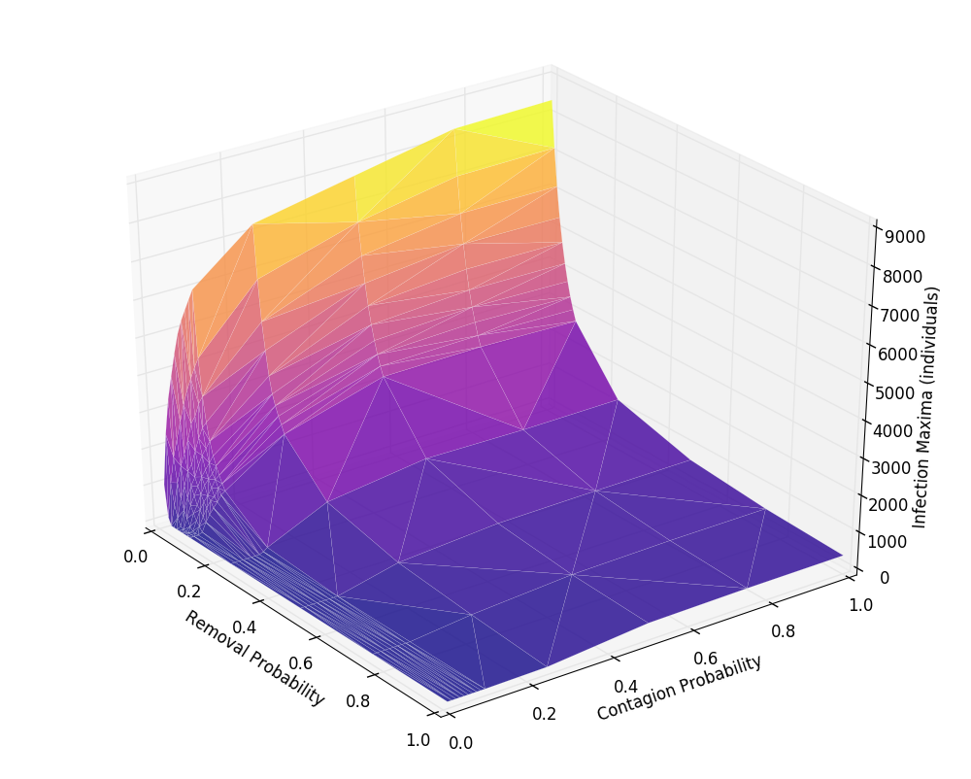
Surfaces
Spherical Lattice Infection Maxima
Square Lattice Infection Maxima

Slide 18
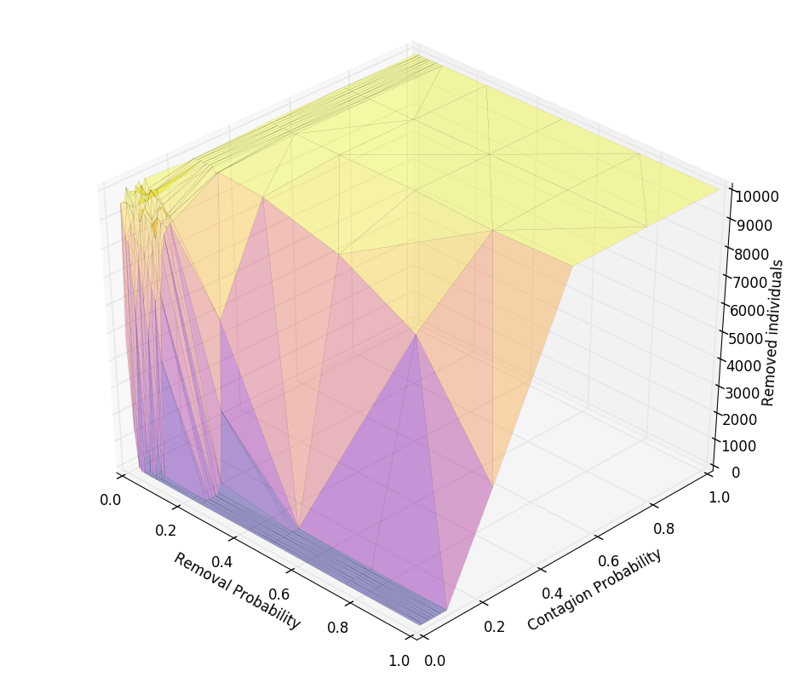
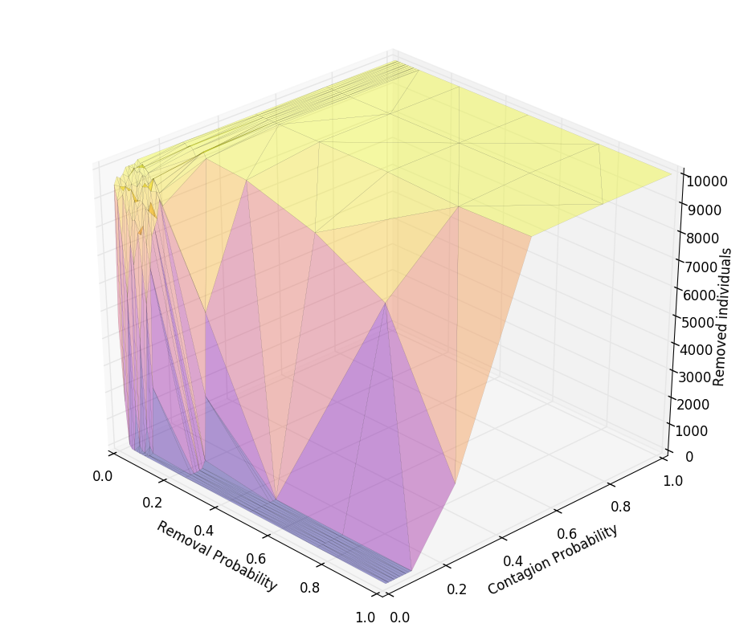
Surfaces
Spherical Lattice Removal Maxima
Square Lattice Removal Maxima

Slide 19
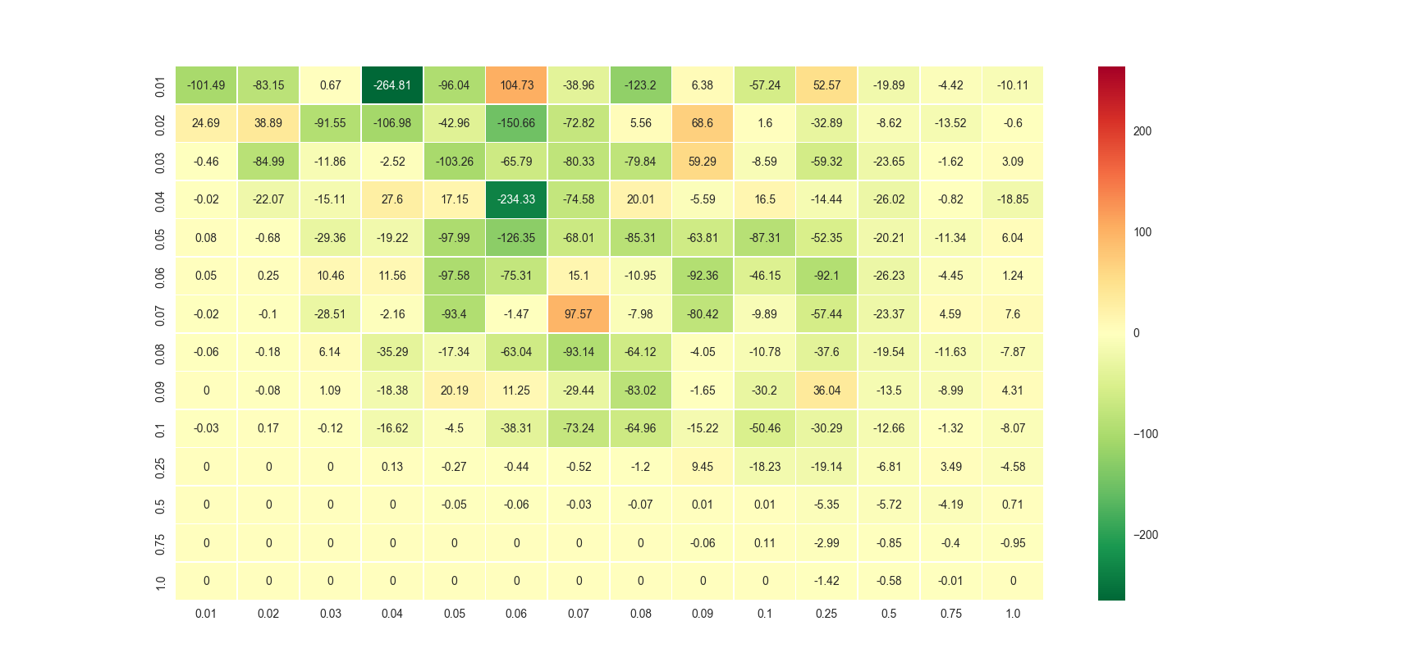
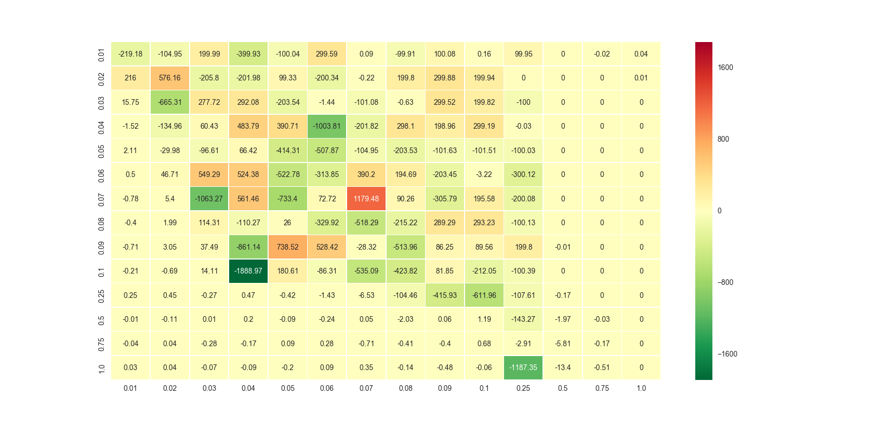
Differences
Infection Maxima (Sqr – Sph)
Removal Maxima (Sqr – Sph)

Slide 20
Conclusions

Slide 21
Influence of Space/Network
Variables have to be adjusted between spatial and non-spatial cases, as in the later one processes occur at a much faster pace for similar coeficients
In the cases studied, the square lattice approximated well the spherical one
Spatial lattices allow for more effects of randomness to arise, or at least contributes to their visibility.

Slide 22
Coefficients
High contagion and removal coefficients tend to be uniform and predictable.
High c and low r – Early and high infection peaks, total removal over time
High r and low c – Infection dies out fast
Most coefficients with low r – total removal
Low c and low r – tend to have no high infection peaks but can have total removal

Slide 23
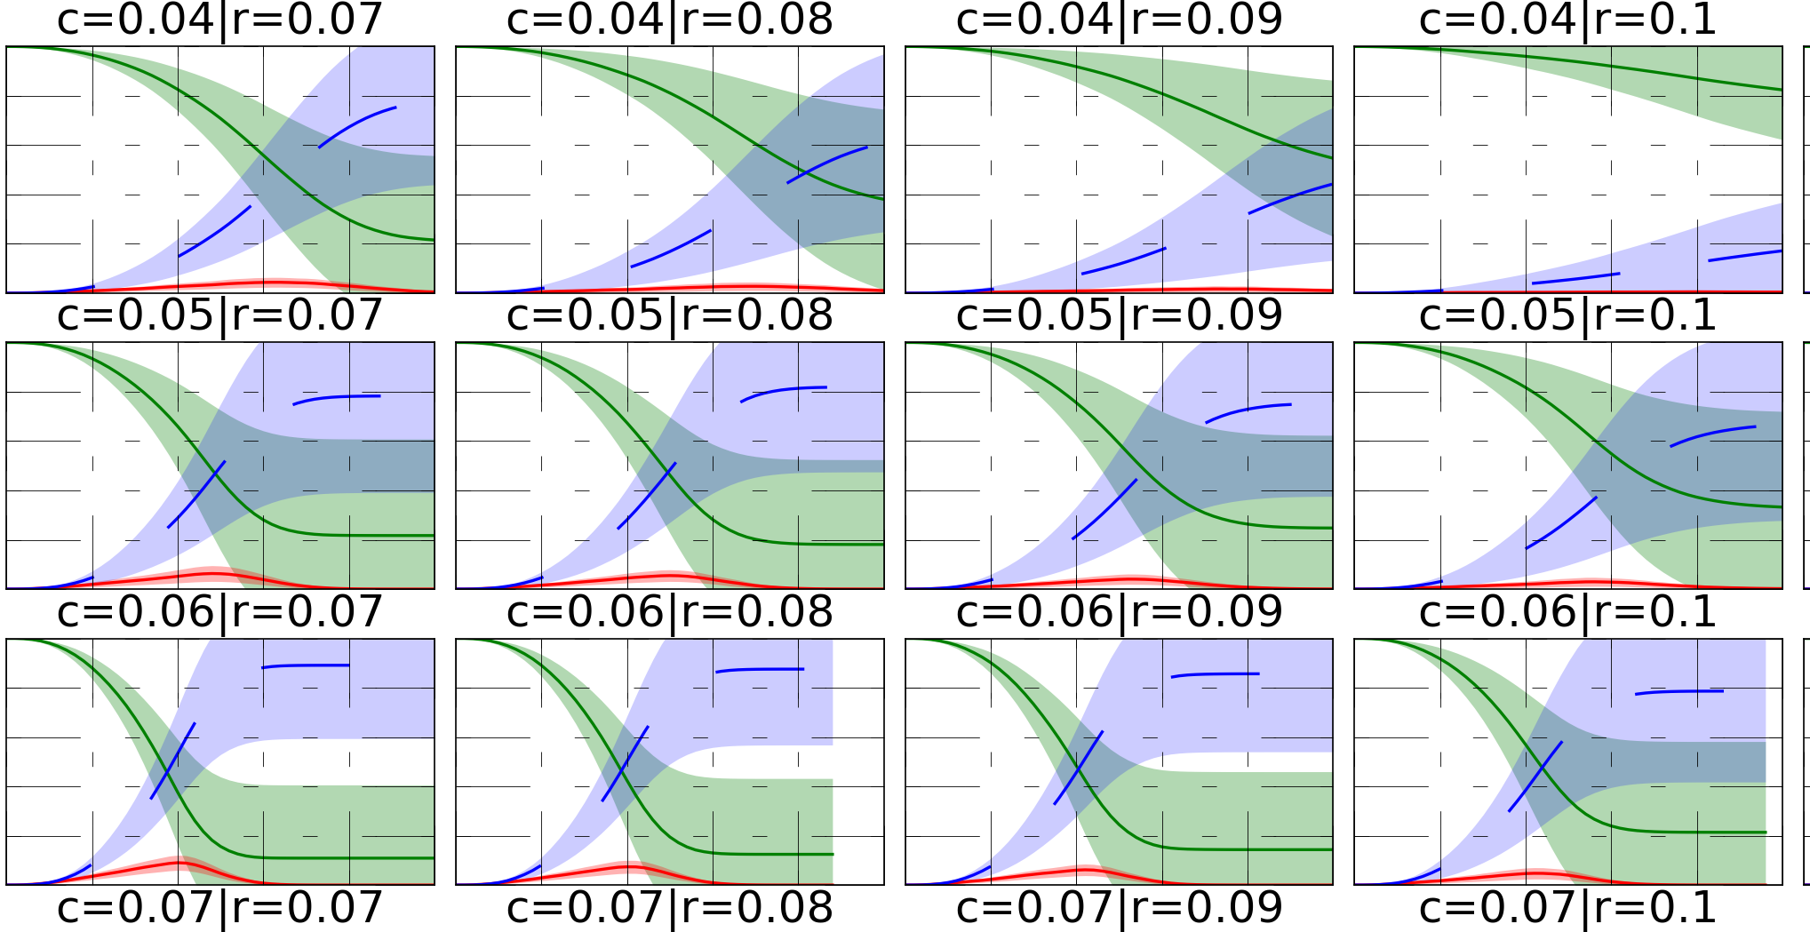
Interesting Cases
Certain border combinations create highly unpredictable outcomes, with standard deviations that make the final results ultimately meaningless as in cases where c = 0.3~0.7 r

Slide 24
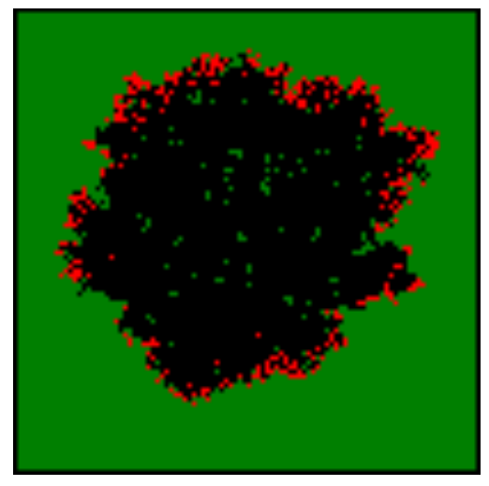
Stochastic/Probabilistic Effects
Non infected islands

Slide 25
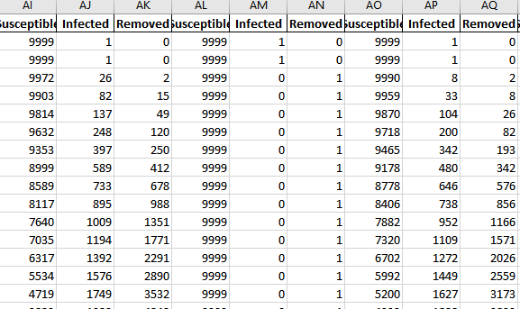
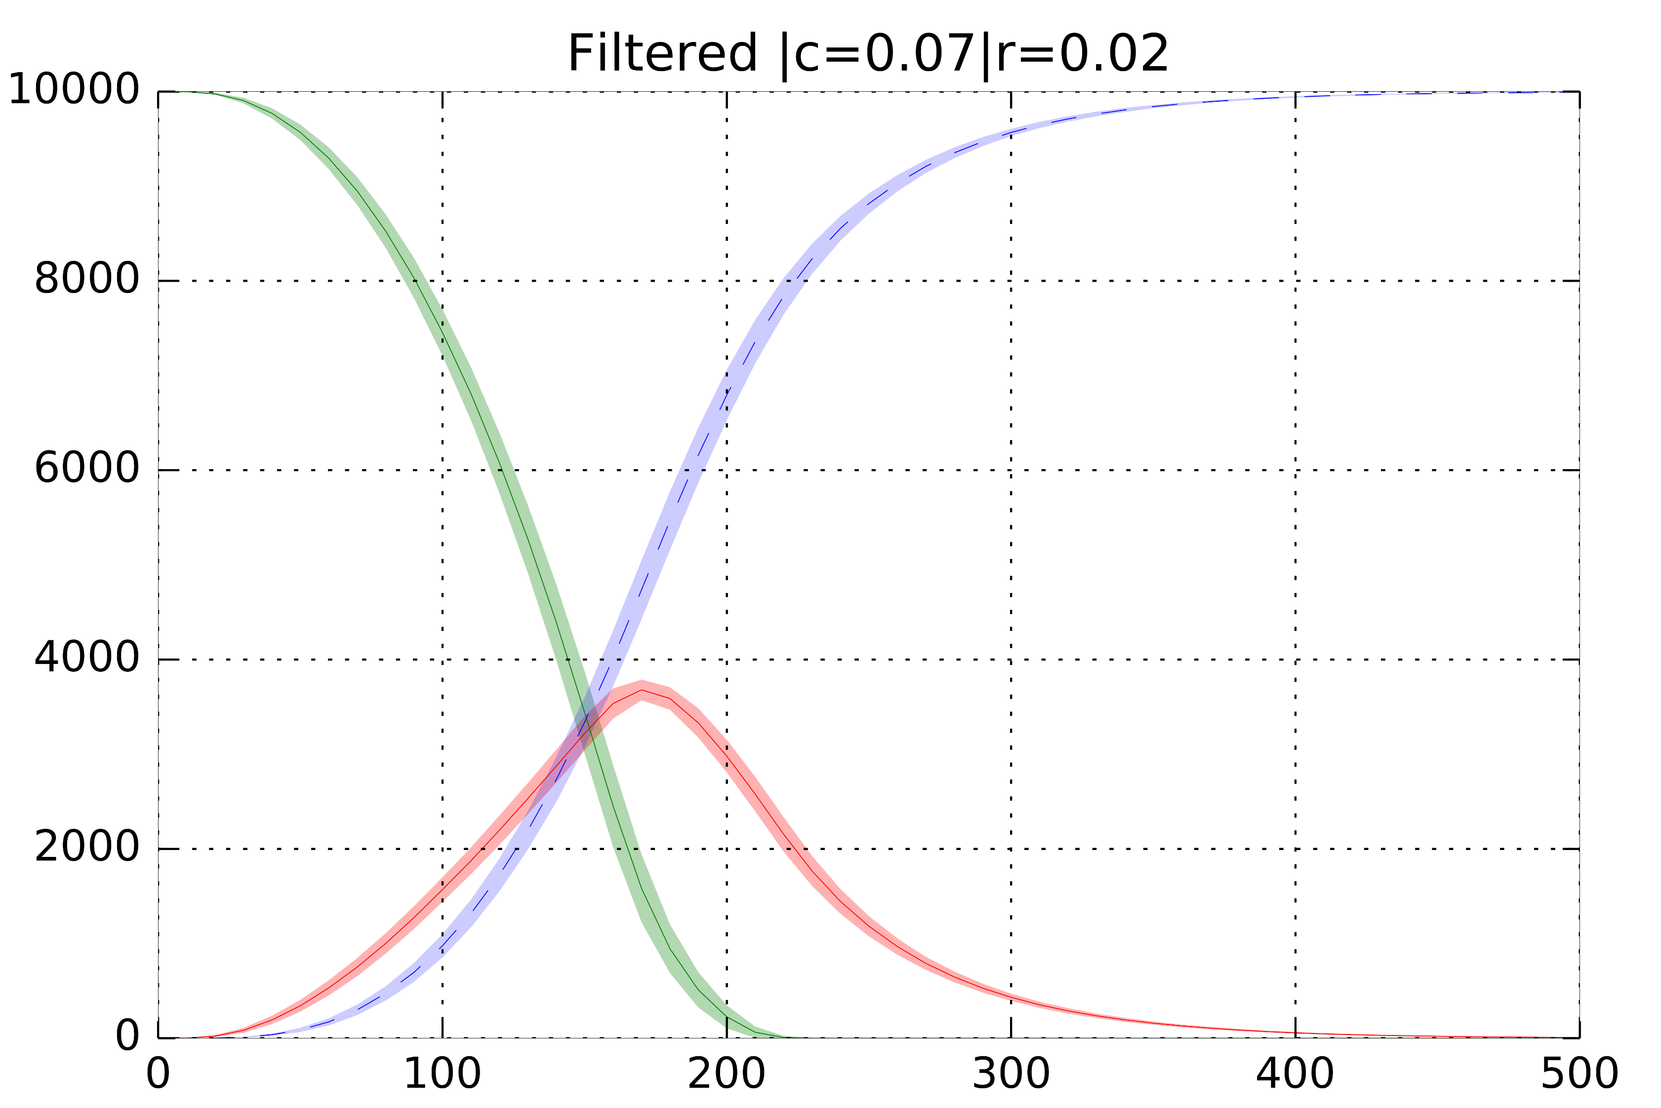
Stochastic/Probabilistic Effects
“Zero Tables”

Slide 26
Further Steps

Slide 27
More detailed Coefficient Studies
Higher number of simulations
Improved speed
Better filtering

Slide 28
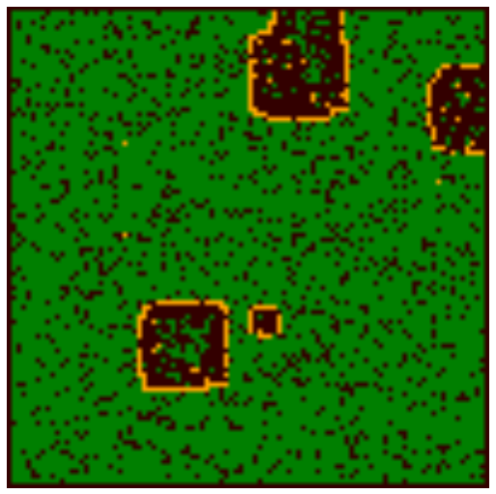
Lattice Masks
Non uniform / random initial population
Infection starting in other places other than the center may increase visibility of spatial effects

Slide 29
Questions

Slide 30
Thank You

